Slide 1
Sports Facilities and Transportation in Trentino
KGE 2023 - Patrick Nanys

Slide 2
Phase 1 - Purpose Formalization
Purpose
KG aims to provide insights into the availability and distribution of sports facilities, and how they are linked with different modes of transportation

Slide 3
Phase 1 - Purpose Formalization
Scenarios
Bus trip
Train trip
Morning (7-12AM)
Afternoon (1PM-5PM)
Evening (after 5PM)
Urban trip

Slide 4
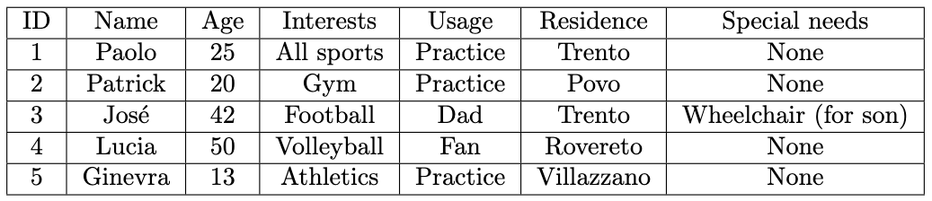
Phase 1 - Purpose Formalization
Personas

Slide 5
Phase 1 - Purpose Formalization
Competency questions (CQs)
Paolo lives in Trento and is in love with sports. Which facilities can Paolo use in Trento that is in walking distance to him?
Patrick lives in Povo and would like to go to a gym in the morning to work out. Which is the closest gym to him that is open at a specific time?
Jos e has a son and who is in a wheelchair and they live in Trento. He wants his son to enjoy playing football. Which transportation route options do they have that is wheelchair accessible?
Lucia is a Volleyball fan in Rovereto and loves to watch volleyball matches, but she is not that into long walks and she prefers buses. Which urban bus route should she take to the next match that involves the least amount of walking?
Ginevra lives in Villazzano and she is a professional athlete. Which track has a tartan surface and where she needs to walk the least before and after practices while taking public transport?

Slide 6
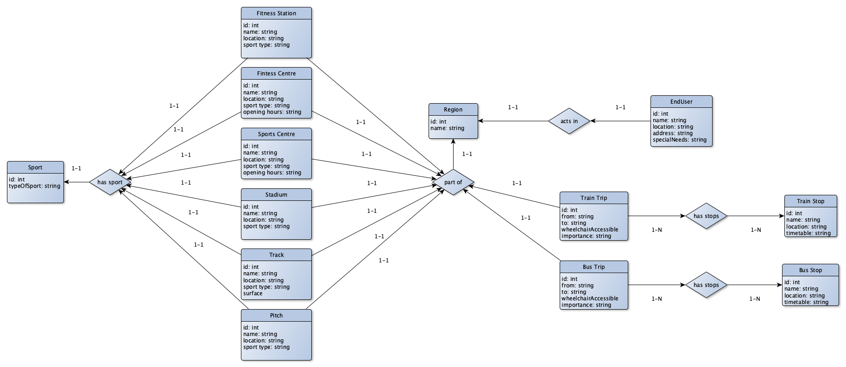
Phase 1 - Purpose Formalization
ER model

Slide 7
Phase 2 - Information Gathering
Knowledge and Data Sources
Knowledge layer:
Schema.org
DataScientia LiveKnowledge - OSM Lightweight Ontology
Data layer:
OpenStreetMap - openstreetmap.org
Overpass Turbo - overpass-turbo.eu
Overpass API - overpass-api.de
consumer
producer
create schemas
create cleaned datasets

Slide 8
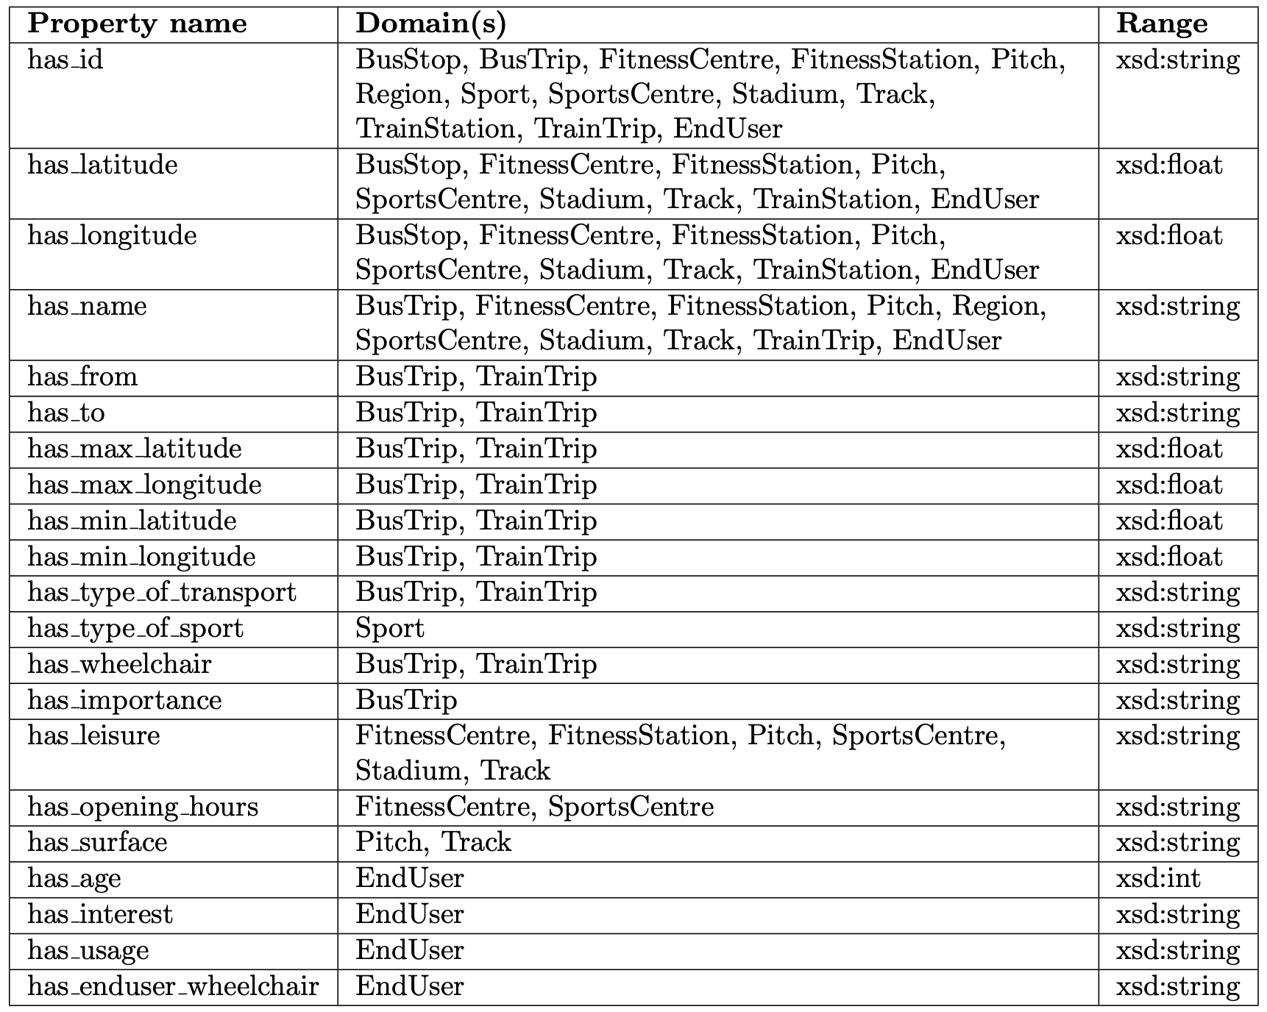
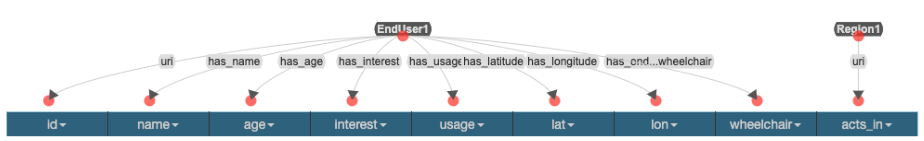
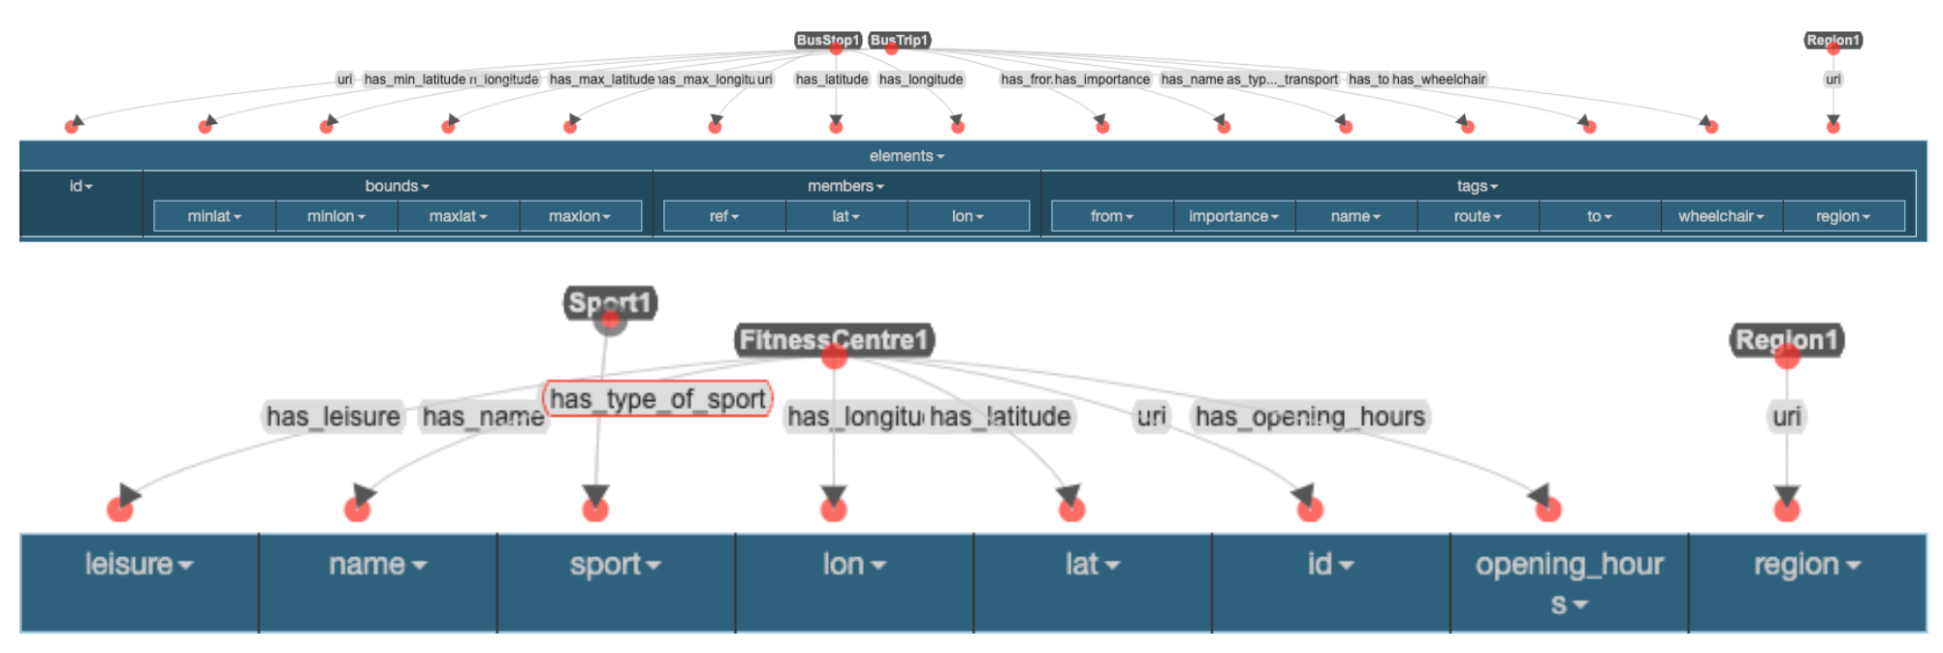
Phase 2 - Information Gathering
Protege and Karma

Slide 9
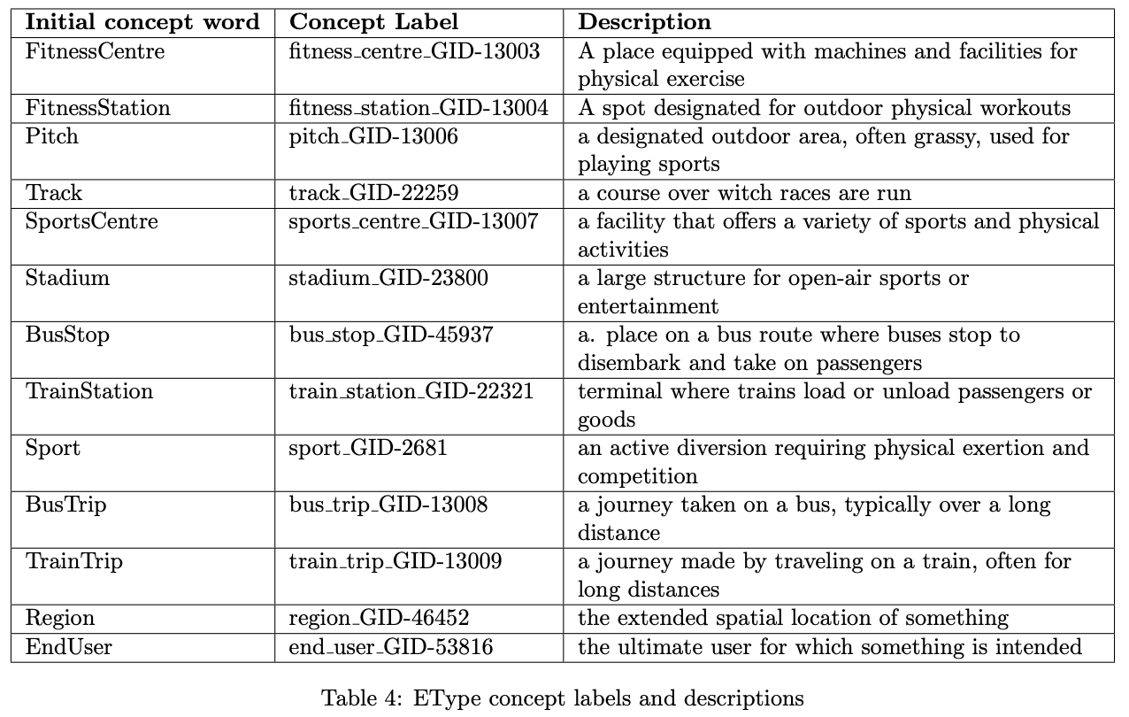
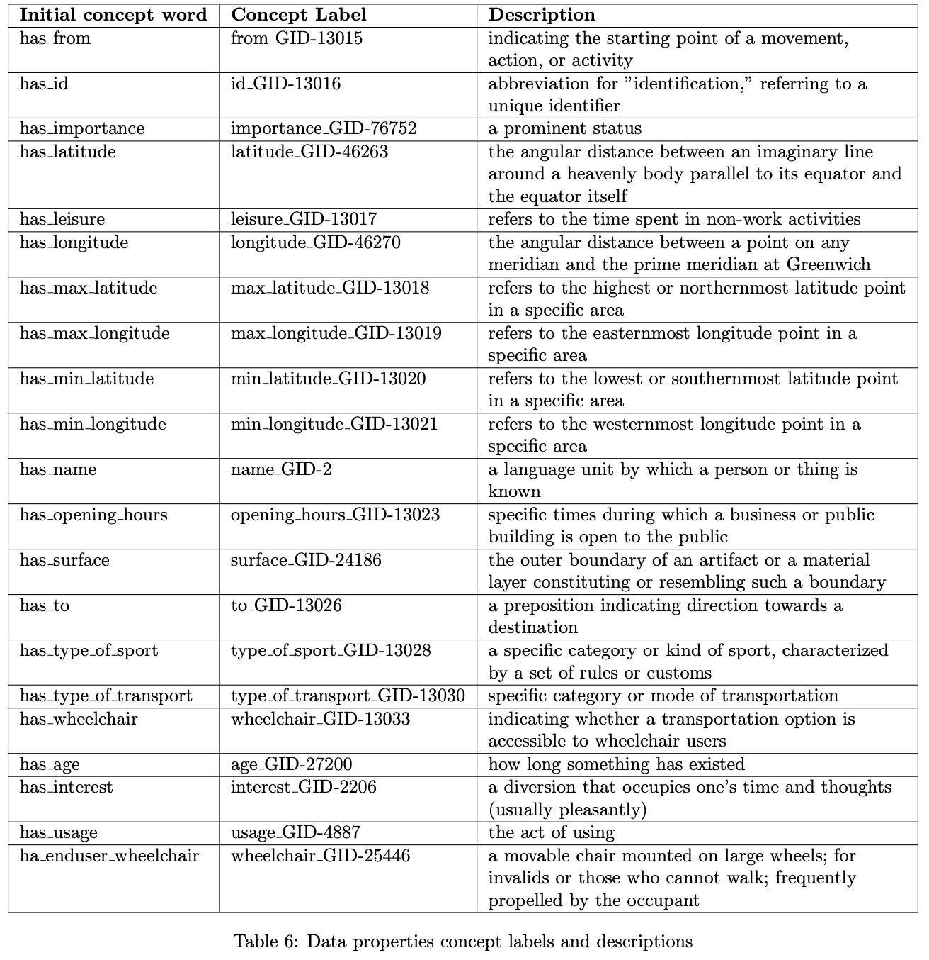
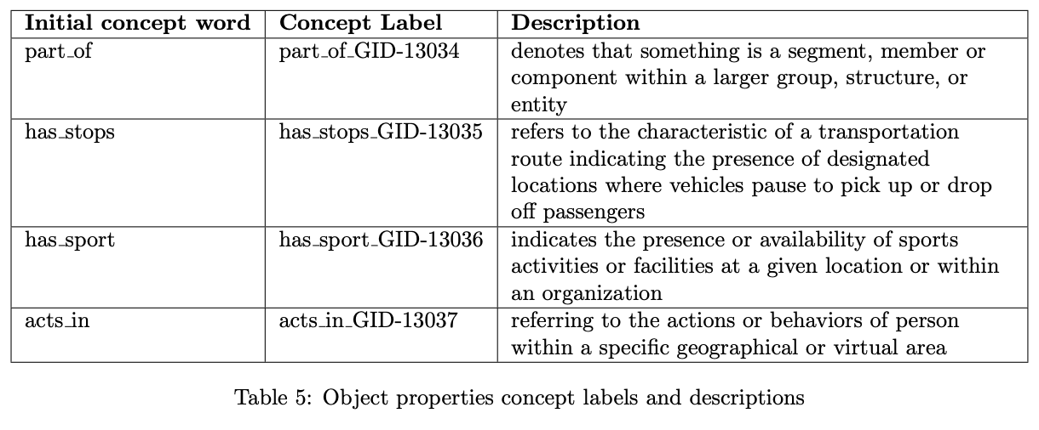
Phase 3 - Language Definition

Slide 10
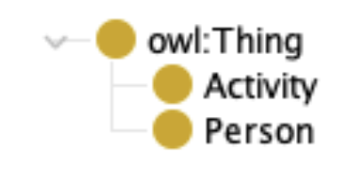
Phase 4 - Knowledge Definition
Ontology
Schema.org:
Intangible
Trip
BusTrip
TrainTrip
Place
CivicStructure
BusStop
TrainStation
OSM Lightweight Ontology:
Region
Custom Ontology

Slide 11
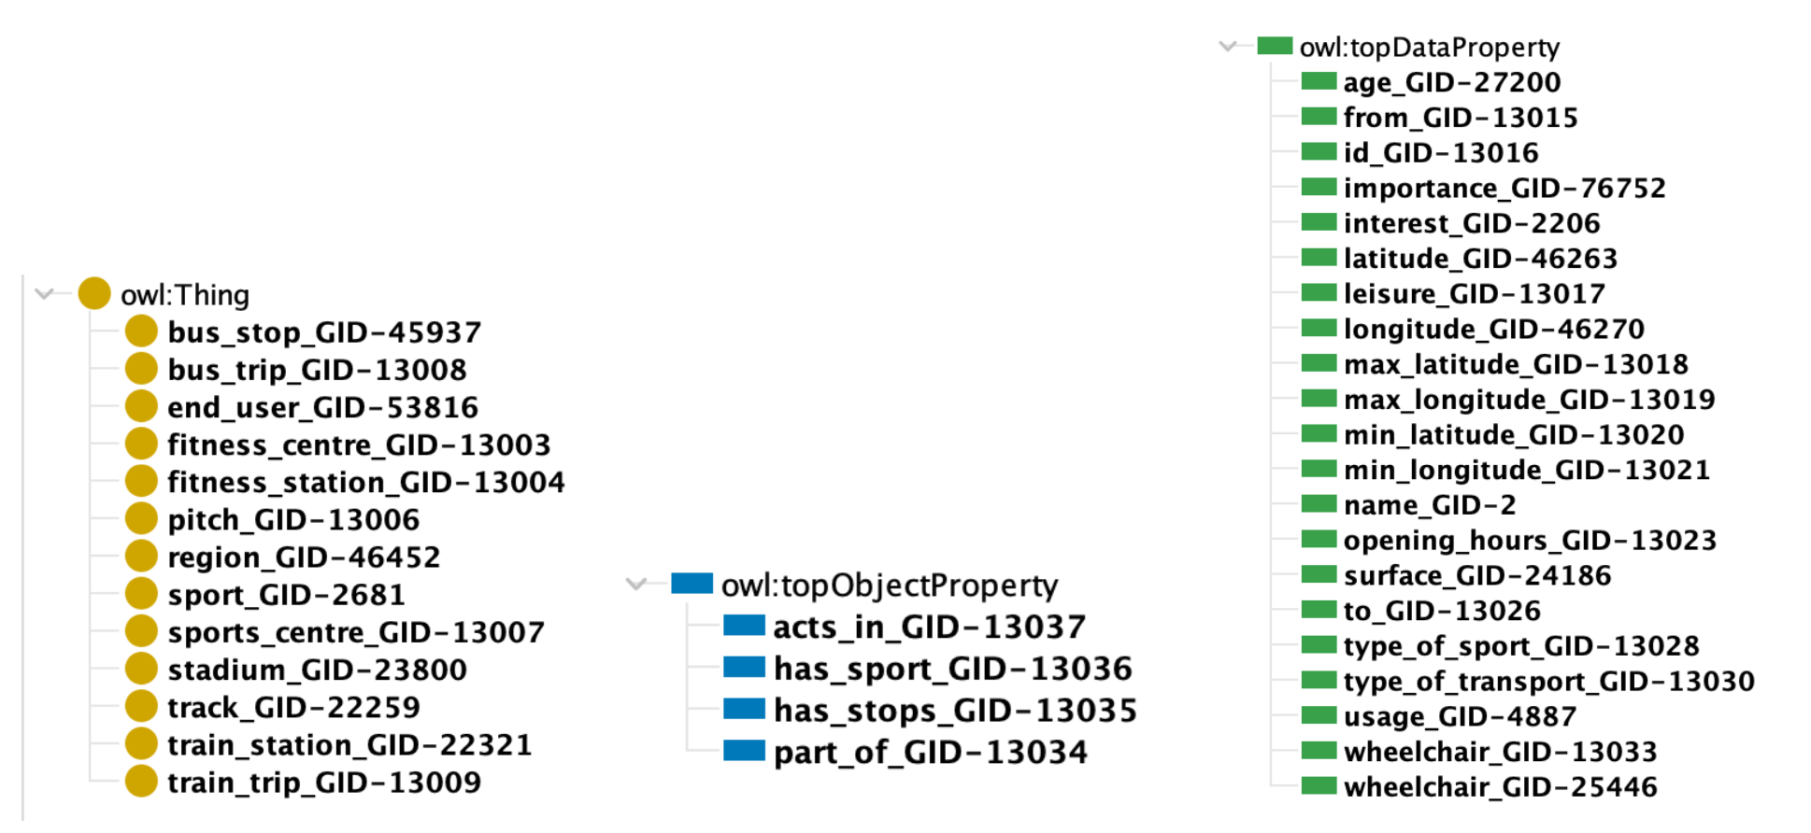
Phase 4 - Knowledge Definition
Teleology

Slide 12
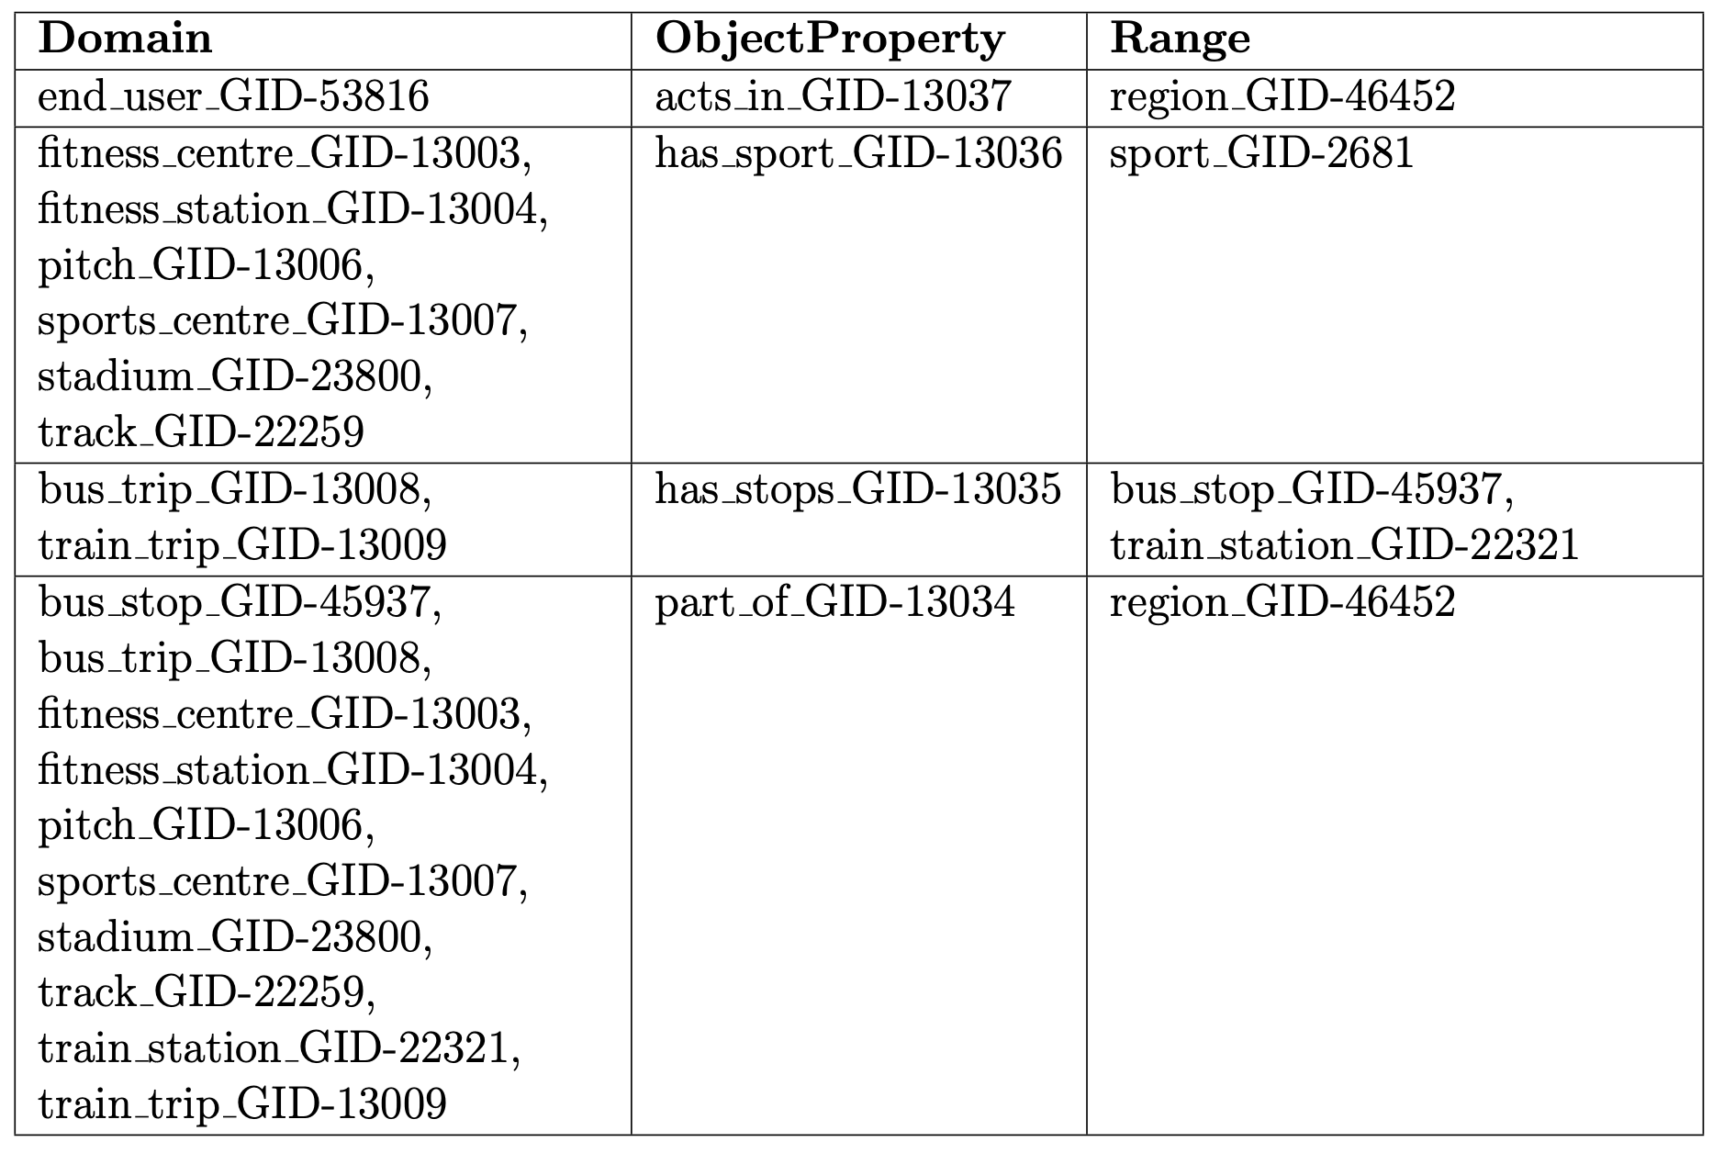
Phase 4 - Knowledge Definition
Teleology

Slide 13
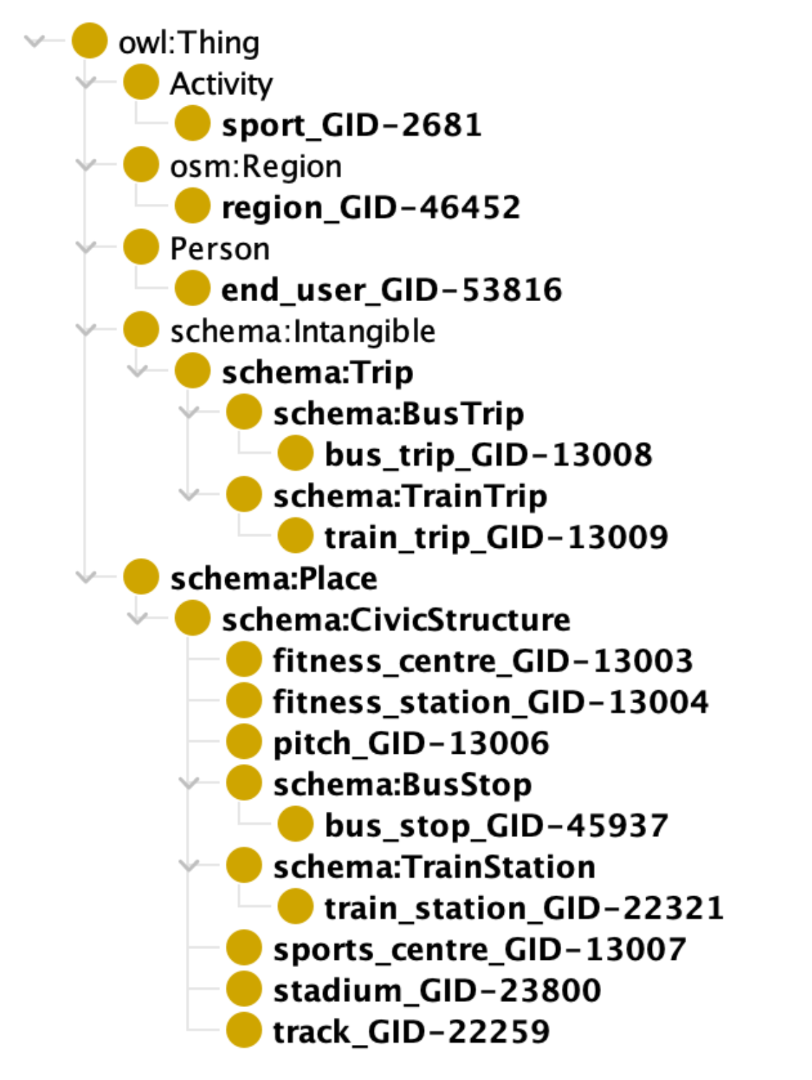
Phase 4 - Knowledge Definition
Teleontology

Slide 14
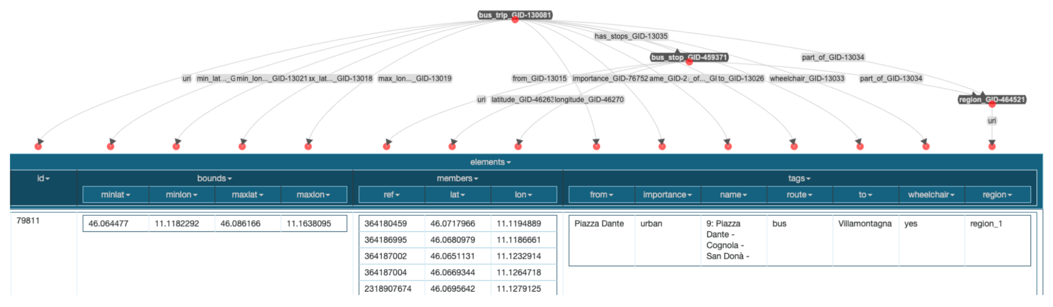
Phase 5 - Data Definition

Slide 15
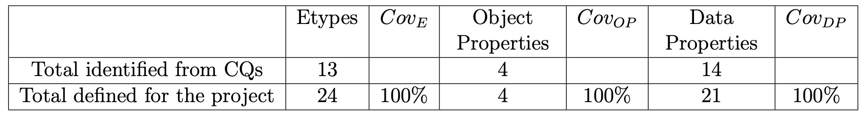
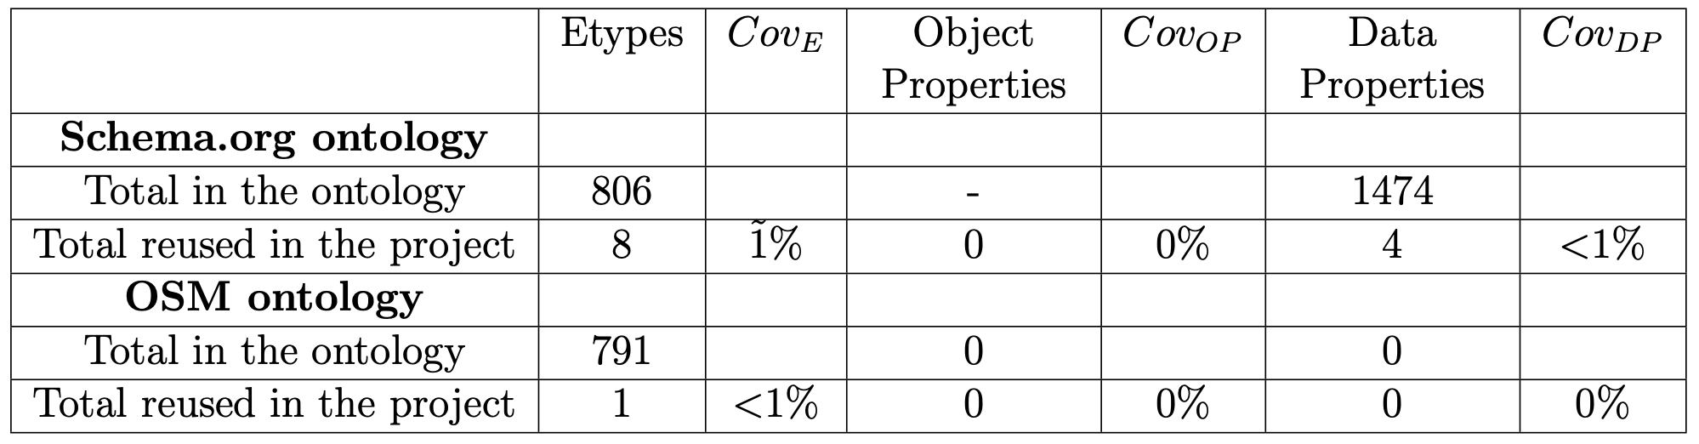
Knowledge Graph evaluation

Slide 16
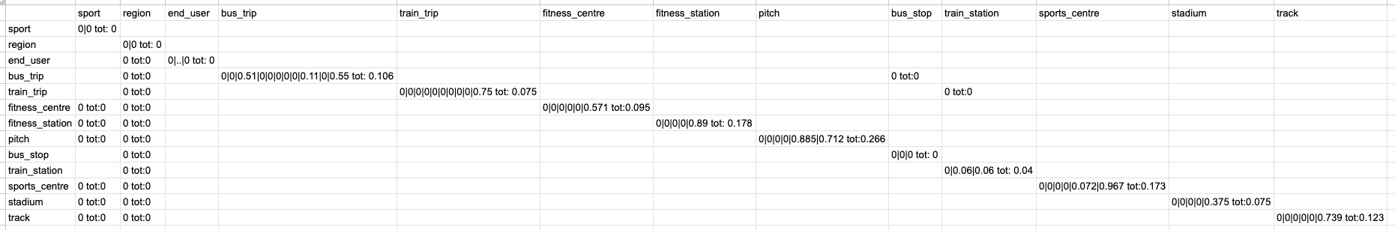
Knowledge Graph evaluation

Slide 17
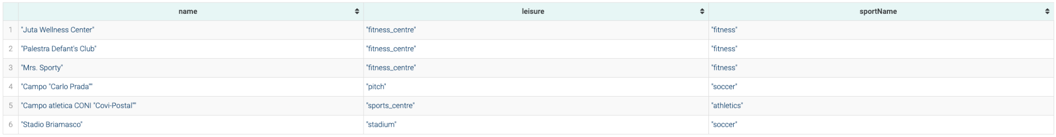
Knowledge Graph querying
PREFIX etype: <http://knowdive.disi.unitn.it/etype#>
PREFIX omgeo: <http://www.ontotext.com/owlim/geo#>
SELECT ?name ?leisure ?sportName
WHERE {
BIND("Paolo" AS ?queryName)
BIND(2 AS ?walkingDistance)
?user etype:name_GID-2 ?userName .
?user etype:latitude_GID-46263 ?userLat .
?user etype:longitude_GID-46270 ?userLon .
?facility etype:leisure_GID-13017 ?leisure .
?facility etype:name_GID-2 ?name .
?facility etype:latitude_GID-46263 ?facilityLat .
?facility etype:longitude_GID-46270 ?facilityLon .
?facility etype:has_sport_GID-13036 ?sport .
?sport etype:type_of_sport_GID-13028 ?sportName .
FILTER(?userName = ?queryName)
BIND(omgeo:distance(?userLat, ?userLon, ?facilityLat, ?facilityLon)
AS ?distance)
FILTER(?distance < ?walkingDistance)
}
CQ1 Paolo lives in Trento and is in love with sports. Which facilities can Paolo use in Trento that is in walking distance to him?

Slide 18
Knowledge Graph querying
PREFIX etype: <http://knowdive.disi.unitn.it/etype#>
PREFIX omgeo: <http://www.ontotext.com/owlim/geo#>
SELECT ?name ?leisure ?sportName ?distance ?openingHours WHERE {
BIND("Patrick" AS ?queryName)
?user etype:name_GID-2 ?userName .
?user etype:latitude_GID-46263 ?userLat .
?user etype:longitude_GID-46270 ?userLon .
?user etype:interest_GID-2206 ?userSportInterest .
?facility etype:leisure_GID-13017 ?leisure .
?facility etype:name_GID-2 ?name .
?facility etype:latitude_GID-46263 ?facilityLat .
?facility etype:longitude_GID-46270 ?facilityLon .
?facility etype:has_sport_GID-13036 ?sport .
?facility etype:opening_hours_GID-13023 ?openingHours .
?sport etype:type_of_sport_GID-13028 ?sportName .
FILTER(?userName = ?queryName)
FILTER(?sportName = ?userSportInterest)
BIND(omgeo:distance(?userLat, ?userLon, ?facilityLat, ?facilityLon) AS ?distance)
}
ORDER BY ASC(?distance)
LIMIT 2
CQ2 Patrick lives in Povo and would like to go to a gym in the morning to work out. Which is the closest gym to him that is open at a specific time?

Slide 19
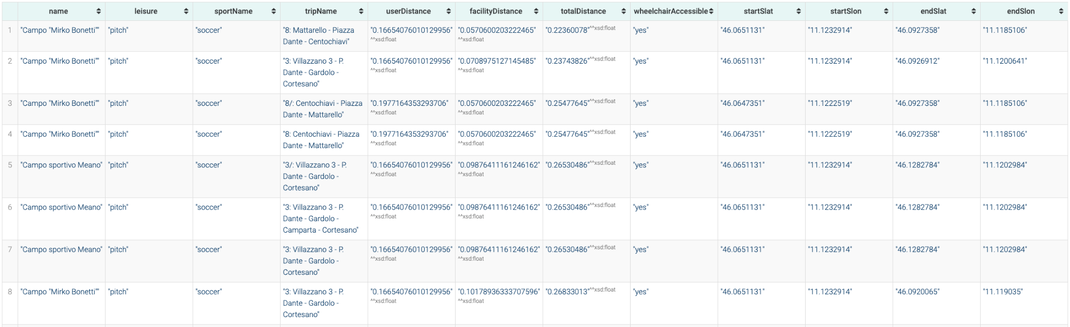
Knowledge Graph querying
PREFIX etype: <http://knowdive.disi.unitn.it/etype#>
PREFIX omgeo: <http://www.ontotext.com/owlim/geo#>
PREFIX xsd: <http://www.w3.org/2001/XMLSchema#>
SELECT DISTINCT ?name ?leisure ?sportName ?tripName ?userDistance
?facilityDistance ?totalDistance ?wheelchairAccessible WHERE {
BIND("JosÃ©" AS ?queryName)
?user etype:name_GID-2 ?userName .
?user etype:latitude_GID-46263 ?userLat .
?user etype:longitude_GID-46270 ?userLon .
?user etype:interest_GID-2206 ?userSportInterest .
?user etype:wheelchair_GID-25446 ?wheelchairNeed .
?facility etype:leisure_GID-13017 ?leisure .
?facility etype:name_GID-2 ?name .
?facility etype:latitude_GID-46263 ?facilityLat .
?facility etype:longitude_GID-46270 ?facilityLon .
?facility etype:has_sport_GID-13036 ?sport .
?sport etype:type_of_sport_GID-13028 ?sportName .
?trip etype:type_of_transport_GID-13030 ?typeOfTransport .
?trip etype:wheelchair_GID-13033 ?wheelchairAccessible .
?trip etype:name_GID-2 ?tripName .
?trip etype:has_stops_GID-13035 ?startStop .
?startStop etype:latitude_GID-46263 ?startSlat .
?startStop etype:longitude_GID-46270 ?startSlon .
FILTER(?userName = ?queryName)
FILTER(?sportName = ?userSportInterest)
FILTER(?wheelchairAccessible = ?wheelchairNeed)
BIND(omgeo:distance(?userLat, ?userLon, ?startSlat, ?startSlon) AS ?userDistance)
FILTER(?userDistance < 1)
?trip etype:has_stops_GID-13035 ?endStop .
?endStop etype:latitude_GID-46263 ?endSlat .
?endStop etype:longitude_GID-46270 ?endSlon .
BIND(omgeo:distance(?facilityLat, ?facilityLon, ?endSlat, ?endSlon)
AS ?facilityDistance)
BIND((?userDistance + ?facilityDistance) AS ?totalDistance)
FILTER(?totalDistance < 1)
}
ORDER BY ASC(?totalDistance)
LIMIT 10
CQ3 José has a son and who is in a wheelchair and they live in Trento. He wants his son to enjoy playing football. Which transportation route options do they have that is wheelchair accessible?

Slide 20
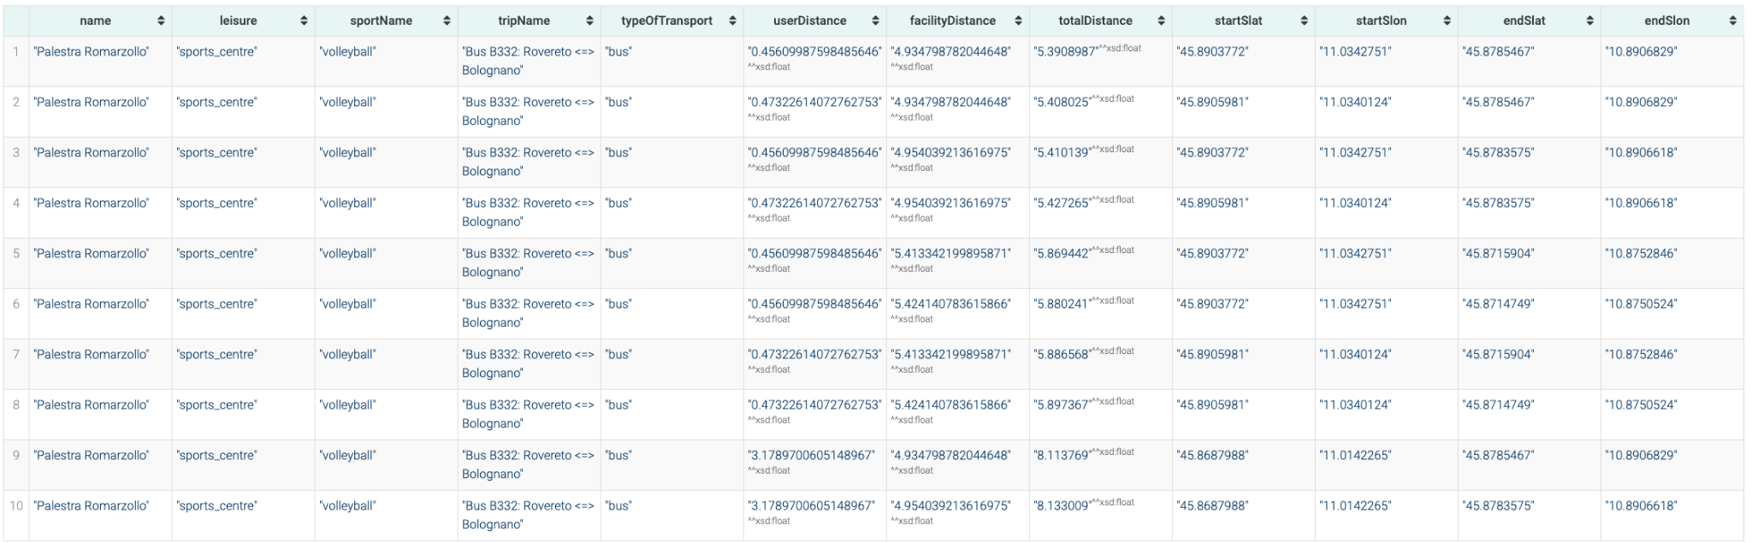
Knowledge Graph querying
PREFIX etype: <http://knowdive.disi.unitn.it/etype#>
PREFIX omgeo: <http://www.ontotext.com/owlim/geo#>
SELECT DISTINCT ?name ?leisure ?sportName ?tripName
?typeOfTransport ?userDistance ?facilityDistance ?totalDistance WHERE {
BIND("Lucia" AS ?queryName)
?user etype:name_GID-2 ?userName .
?user etype:latitude_GID-46263 ?userLat .
?user etype:longitude_GID-46270 ?userLon .
?user etype:interest_GID-2206 ?userSportInterest .
?facility etype:leisure_GID-13017 ?leisure .
?facility etype:name_GID-2 ?name .
?facility etype:latitude_GID-46263 ?facilityLat .
?facility etype:longitude_GID-46270 ?facilityLon .
?facility etype:has_sport_GID-13036 ?sport .
?sport etype:type_of_sport_GID-13028 ?sportName .
?trip etype:type_of_transport_GID-13030 ?typeOfTransport .
?trip etype:name_GID-2 ?tripName .
?trip etype:has_stops_GID-13035 ?startStop .
?startStop etype:latitude_GID-46263 ?startSlat .
?startStop etype:longitude_GID-46270 ?startSlon .
FILTER(?userName = ?queryName)
FILTER(?sportName = ?userSportInterest)
FILTER(?typeOfTransport = "bus")
BIND(omgeo:distance(?userLat, ?userLon, ?startSlat, ?startSlon) AS ?userDistance)
FILTER(?userDistance < 5)
?trip etype:has_stops_GID-13035 ?endStop .
?endStop etype:latitude_GID-46263 ?endSlat .
?endStop etype:longitude_GID-46270 ?endSlon .
BIND(omgeo:distance(?facilityLat, ?facilityLon, ?endSlat, ?endSlon) AS ?facilityDistance)
BIND((?userDistance + ?facilityDistance) AS ?totalDistance)
FILTER(?totalDistance < 10)
}
ORDER BY ASC(?totalDistance)
LIMIT 10
CQ4 Lucia is a Volleyball fan in Rovereto and loves to watch volleyball matches, but she is not that into long walks and she prefers buses. Which urban bus route should she take to the next match that involves the least amount of walking?

Slide 21
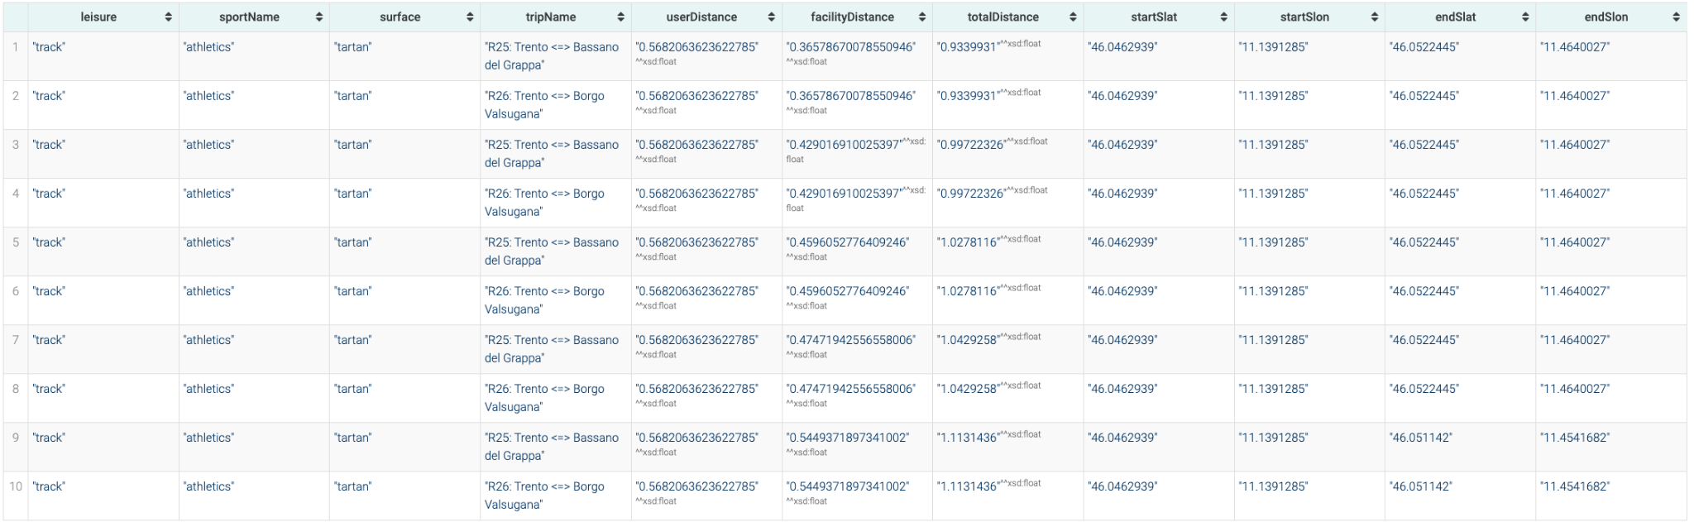
Knowledge Graph querying
PREFIX etype: <http://knowdive.disi.unitn.it/etype#>
PREFIX omgeo: <http://www.ontotext.com/owlim/geo#>
PREFIX xsd: <http://www.w3.org/2001/XMLSchema#>
SELECT ?leisure ?sportName ?surface ?tripName ?userDistance ?facilityDistance
?totalDistance ?startSlat ?startSlon ?endSlat ?endSlon WHERE {
BIND("Ginevra" AS ?queryName)
?user etype:name_GID-2 ?userName .
?user etype:latitude_GID-46263 ?userLat .
?user etype:longitude_GID-46270 ?userLon .
?user etype:interest_GID-2206 ?userSportInterest .
?facility etype:leisure_GID-13017 ?leisure .
?facility etype:latitude_GID-46263 ?facilityLat .
?facility etype:longitude_GID-46270 ?facilityLon .
?facility etype:has_sport_GID-13036 ?sport .
?facility etype:surface_GID-24186 ?surface .
?sport etype:type_of_sport_GID-13028 ?sportName .
?trip etype:type_of_transport_GID-13030 ?typeOfTransport .
?trip etype:name_GID-2 ?tripName .
?trip etype:has_stops_GID-13035 ?startStop .
?startStop etype:latitude_GID-46263 ?startSlat .
?startStop etype:longitude_GID-46270 ?startSlon .
FILTER(?userName = ?queryName)
FILTER(?sportName = ?userSportInterest)
FILTER(?surface = "tartan")
BIND(omgeo:distance(?userLat, ?userLon, ?startSlat, ?startSlon) AS ?userDistance)
FILTER(?userDistance < 1)
?trip etype:has_stops_GID-13035 ?endStop .
?endStop etype:latitude_GID-46263 ?endSlat .
?endStop etype:longitude_GID-46270 ?endSlon .
BIND(omgeo:distance(?facilityLat, ?facilityLon, ?endSlat, ?endSlon) AS ?facilityDistance)
BIND((?userDistance + ?facilityDistance) AS ?totalDistance)
FILTER(?totalDistance < 2)
}
ORDER BY ASC(?totalDistance)
LIMIT 10
CQ5 Ginevra lives in Villazzano and she is a professional athlete. Which track has a tartan surface and where she needs to walk the least before and after practices while taking public transport?

Slide 22
Open issues
Existing alternative available for custom ontologies?
Opening hours data schema change?
Query time optimizations with precomputations?

Slide 23
Thank you for your attention!

